Slide 1

Tweetrumper App
By: Daniel Looney, Samuel Wainright, Nazim Zerrouki, Adam Shandi
Notes:
© Copyright PresentationGo.com – The free PowerPoint library

Slide 2
Motivation
Tweetrumper App is designed to provide real-world 2020 election candidates’ Twitter data
Aggregates data based on categories that concern people when voting in an election (i.e. economy)
Ensures people are well-informed by a social media standpoint
Target audience is all politically-conscious U.S. citizens who are looking to vote in the upcoming election (the program is bipartisan, unbiased)
Built with Next.js, Node.js, JavaScript, HTML, CSS & Python

Slide 3
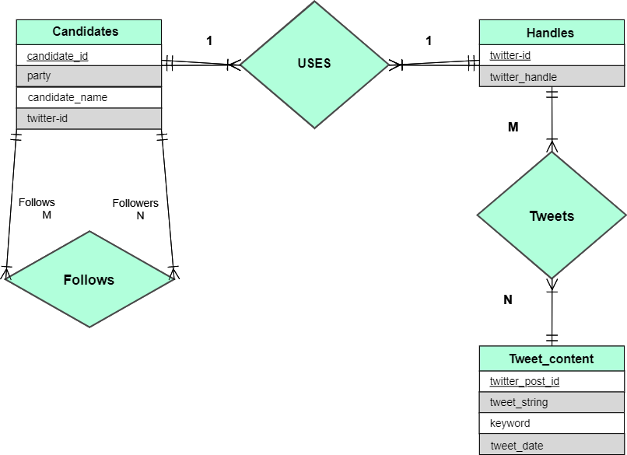
E-R Design

Slide 4
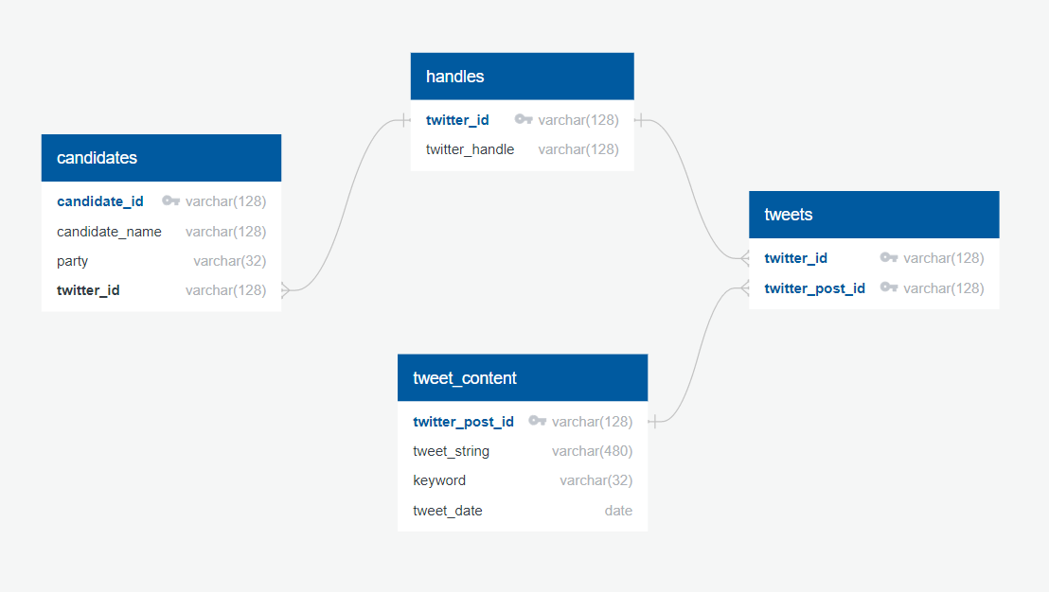
Relational Schema
Notes:
© Copyright PresentationGo.com – The free PowerPoint library

Slide 5
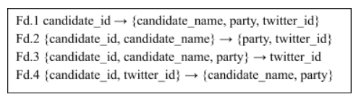
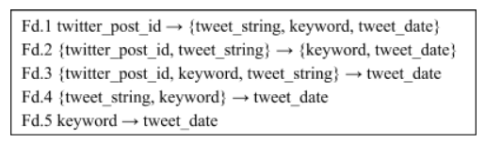
Normalization Proof
Proof for candidates relation:
Proof for tweet_content relation:

Slide 6
Demo

Slide 7
Improvements
PWA
Live/Scheduled Updates
Interface Assets & Design

